Slide 1

Smarter Doorbell: Edge Computing Resolution
based on ESP32-S3 and Edge Impulse

Slide 2


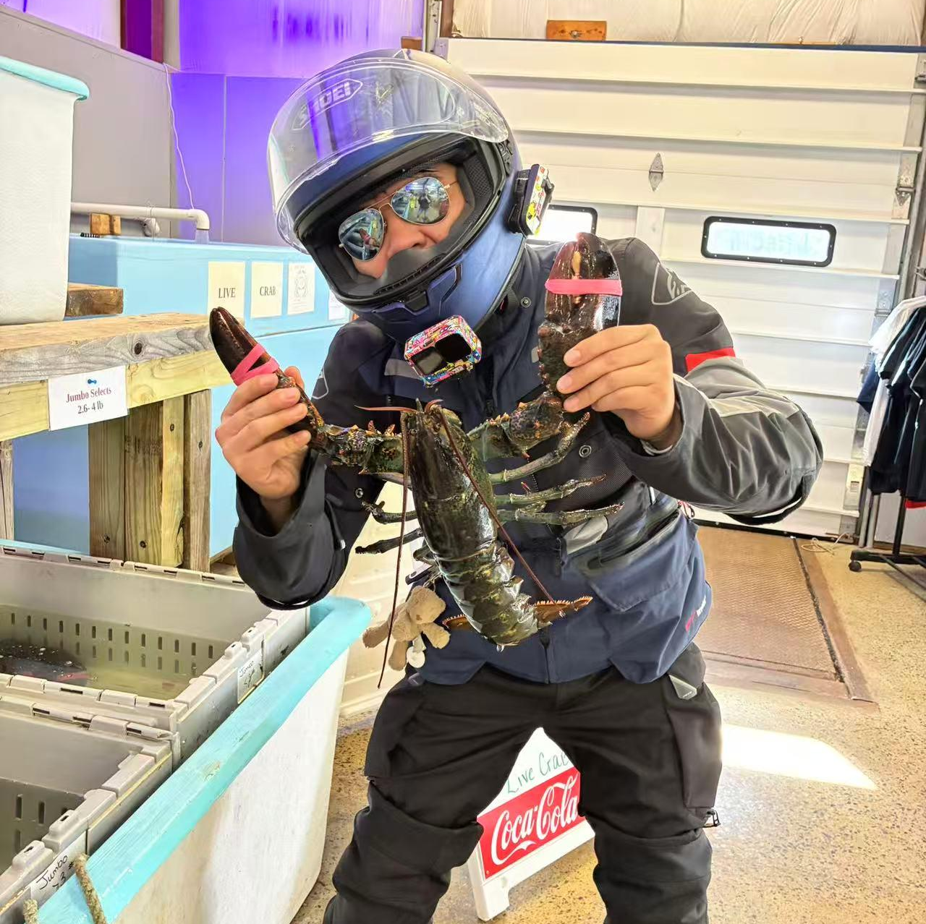
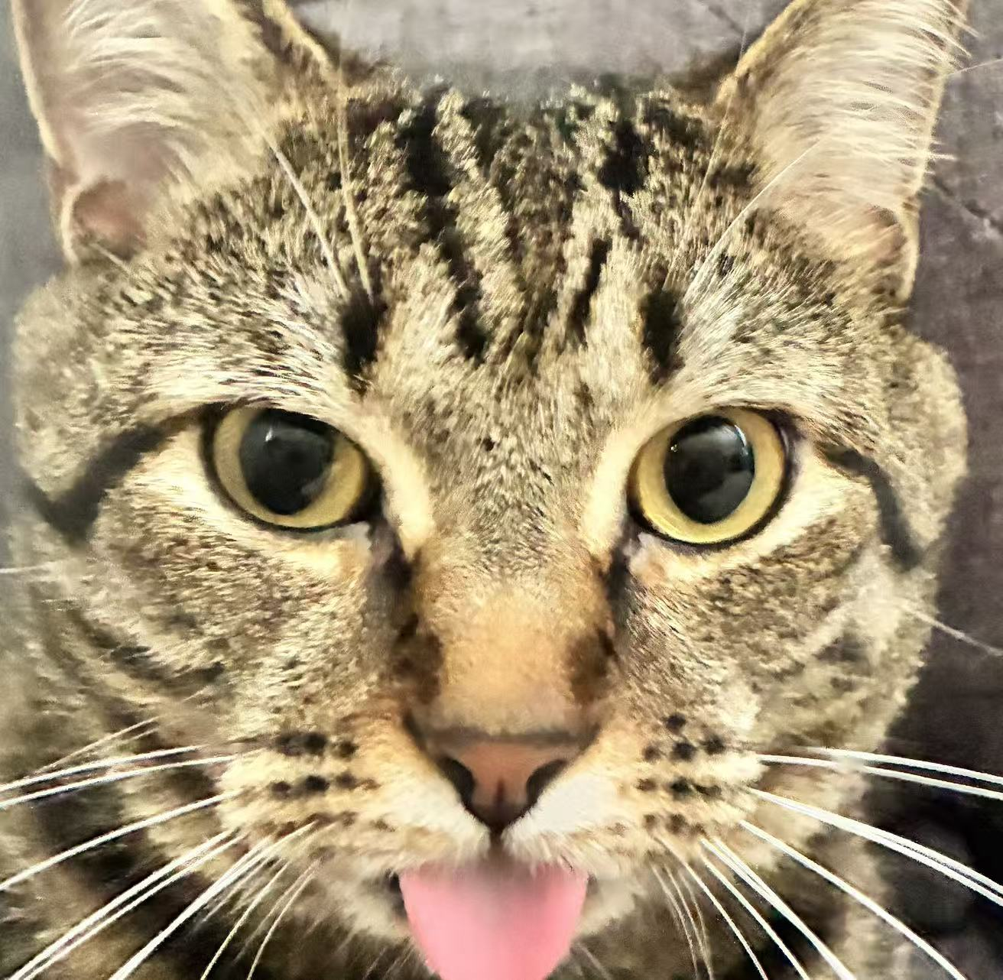
Team members
QUAN
SUN (my cat)
1. 🛠️ Hardware & Environment Setup
2. 🧠 tinyML Model Development
3. 💻 Edge Deployment & Integration
4. ✅ Testing & Finalization
1. Cause Troubles
2. Provide training data

Slide 3
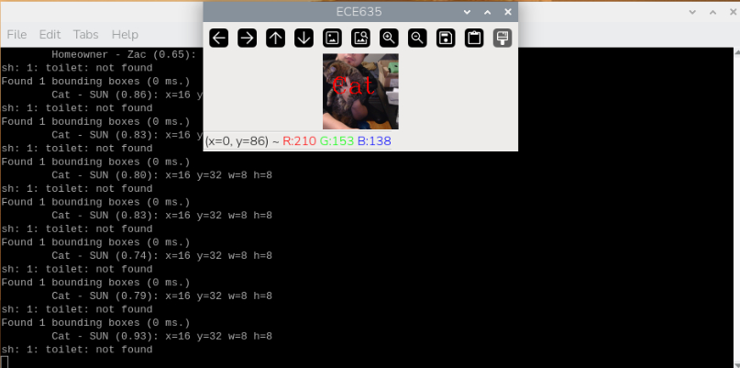
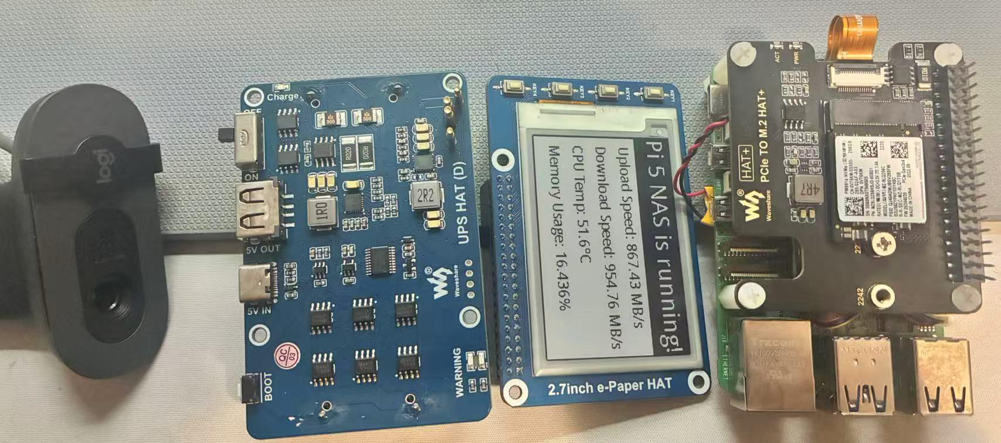
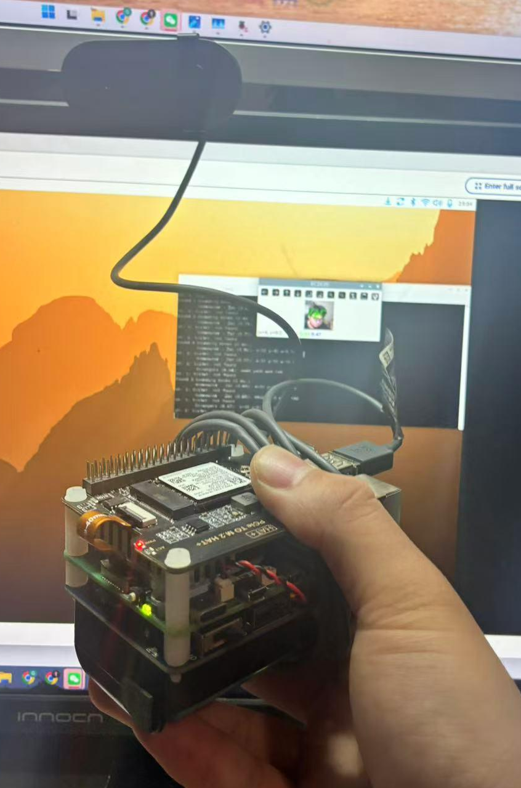
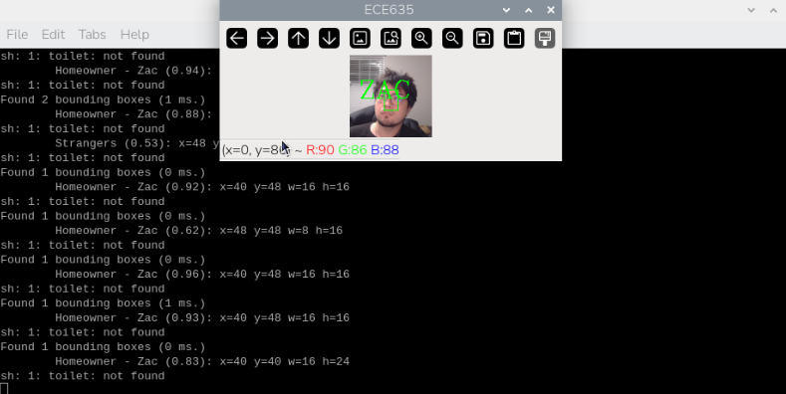
Results: Raspberry Pi 5 Based Smart Doorbell
High Performance: Achieved 30+ FPS for real-time face detection using standard OpenCV libraries.
Ease of Development: Python environment allowed for rapid iteration and testing of complex models.
Successful Recognition: In real environment test, it successfully recognized me, my cat and strangers.

Slide 4
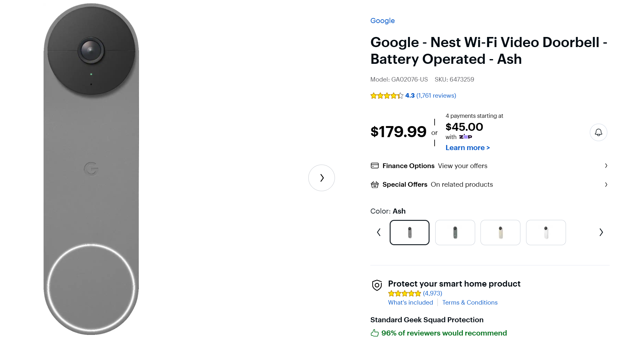
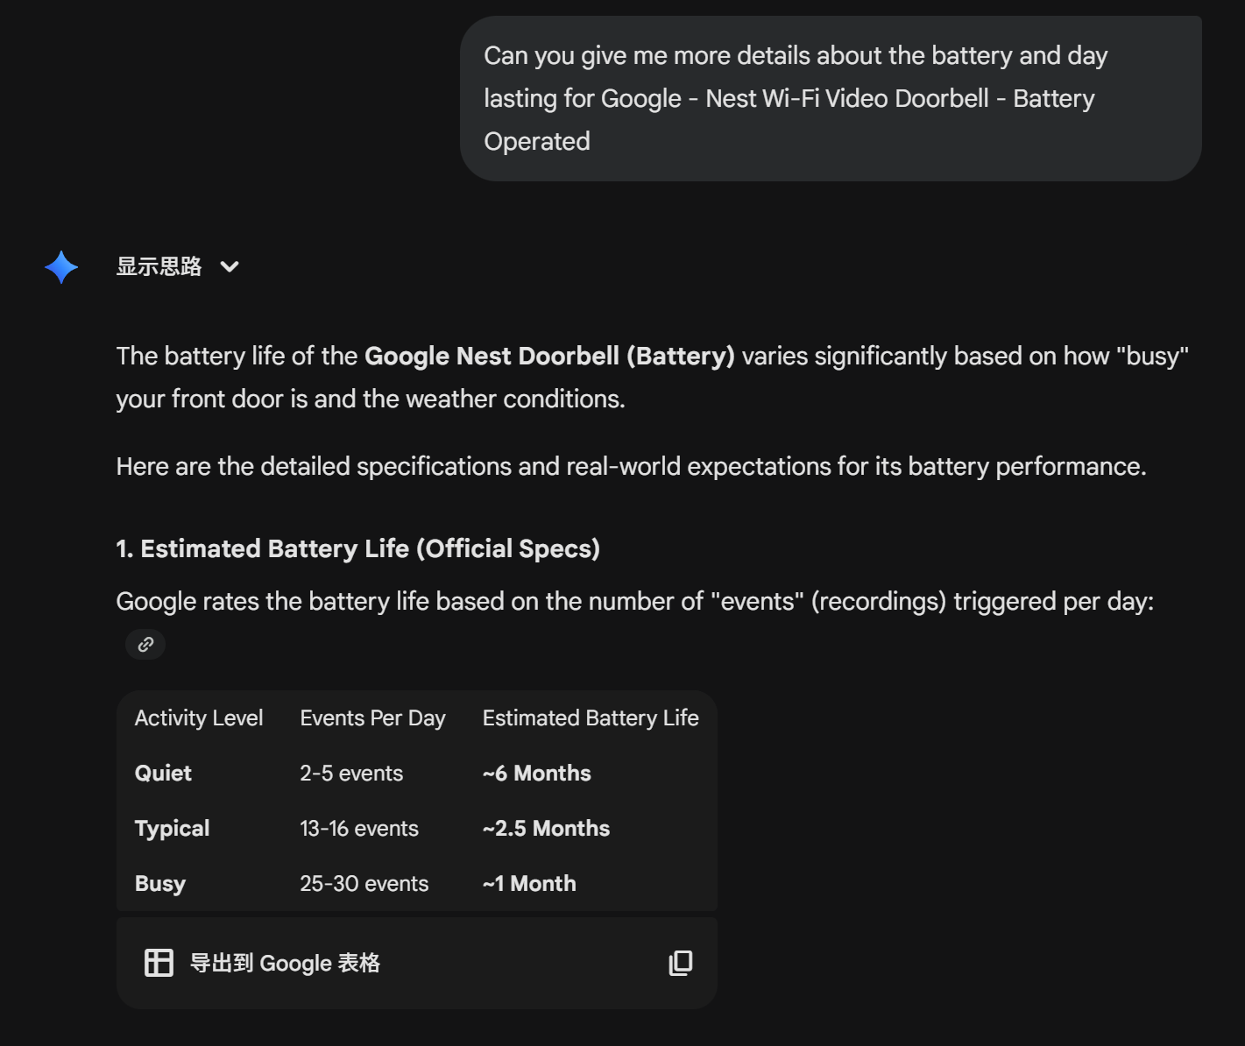
Bottlenecks: The Pi 5 Approach
Power & Heat
High Cost
Large Size
To be Hacked
The Pi 5 is power-hungry, requiring a 5V/3A+ active supply. It cannot run on standard batteries for long, making wireless installation impossible. Active cooling is also required to prevent throttling.
At ~$100, the unit cost is prohibitive for a scalable IoT product. Additionally, the full Linux OS boot time (20-30s) prevents "instant-on" capture when a visitor presses the button.
The whole device size could be 100x100x65 mm since it have the extension board of the ink screen, m2 ssd, cooling fan and batteries
It can be hacked because the whole system was running on the linux system and we exposed the interfaces of HDMI and usb.

Slide 5









The Advantages of TinyML on ESP32S3
Energy Efficient
Low Latency
Privacy
Microcontrollers consume milliwatts, allowing for months of operation on a single battery charge.
Local inference on the ESP32 eliminates the round-trip time to the cloud, providing instant alerts.
Images are processed on-device. No video stream is sent to the cloud, ensuring total user privacy.

Slide 6
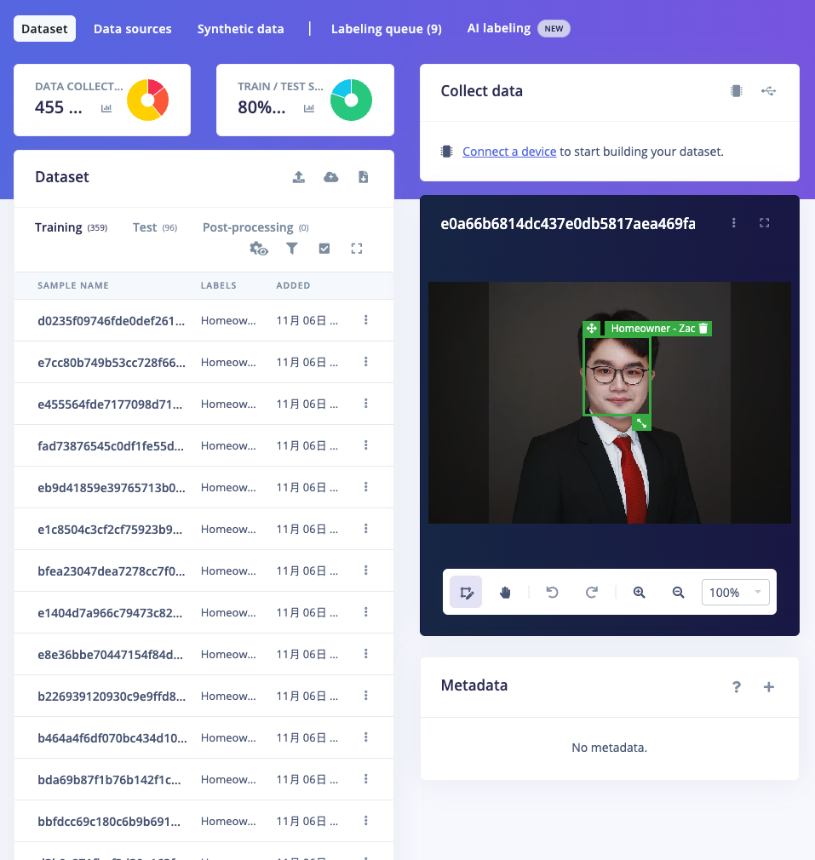
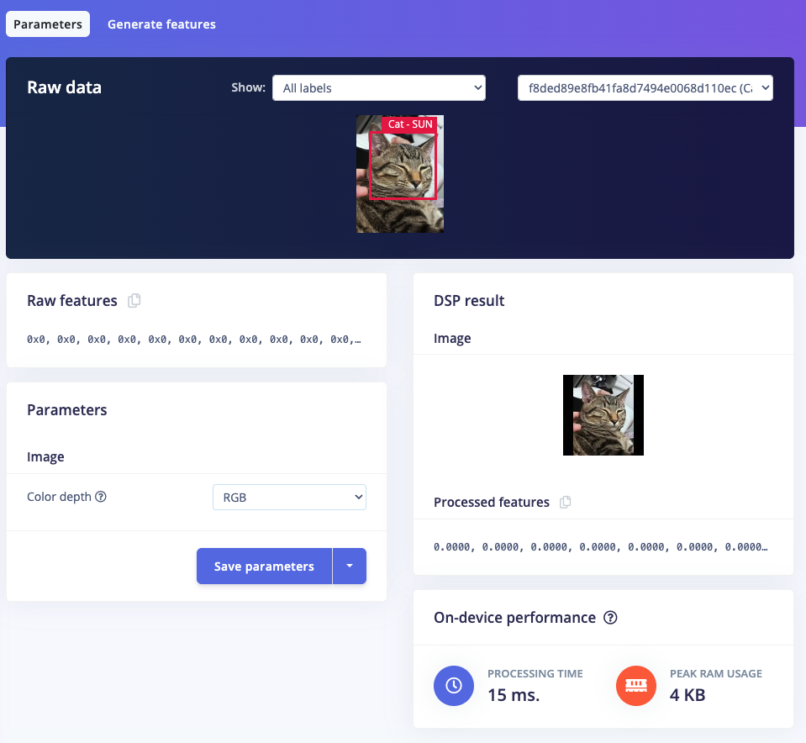
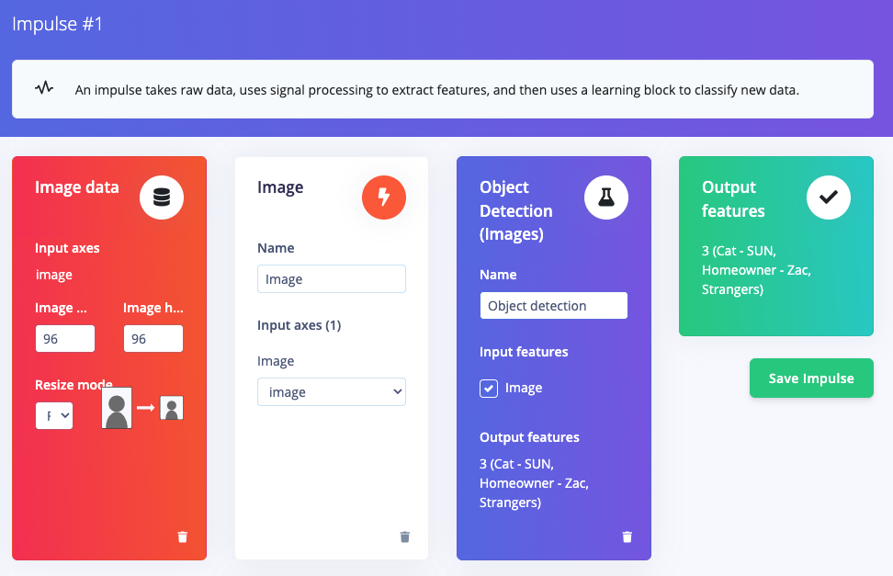


Edge Impulse Pipeline
Data Ingestion
Impulse
DSP
Collecting dataset of known faces.
Create Impulse for model Training
Image preprocessing & resizing.

Slide 7
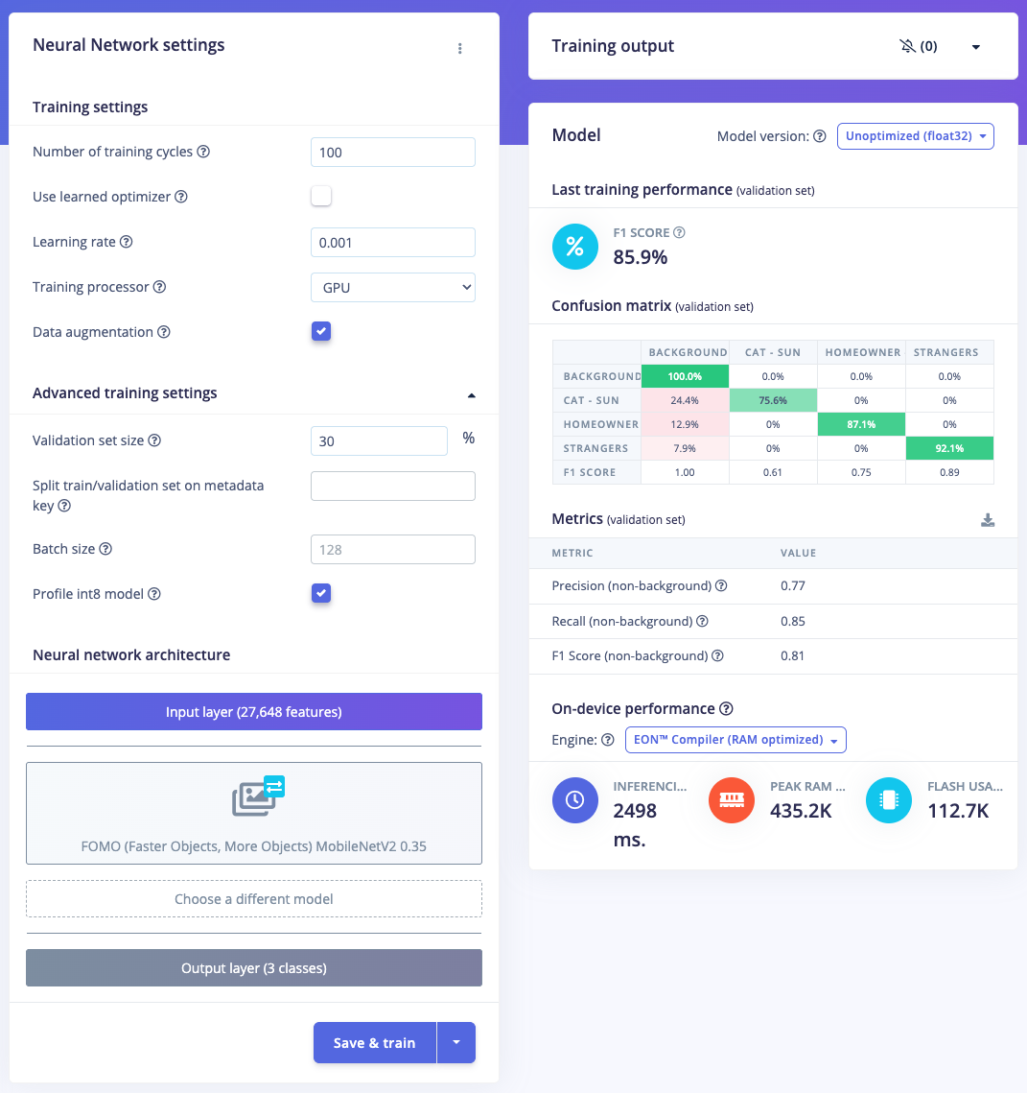
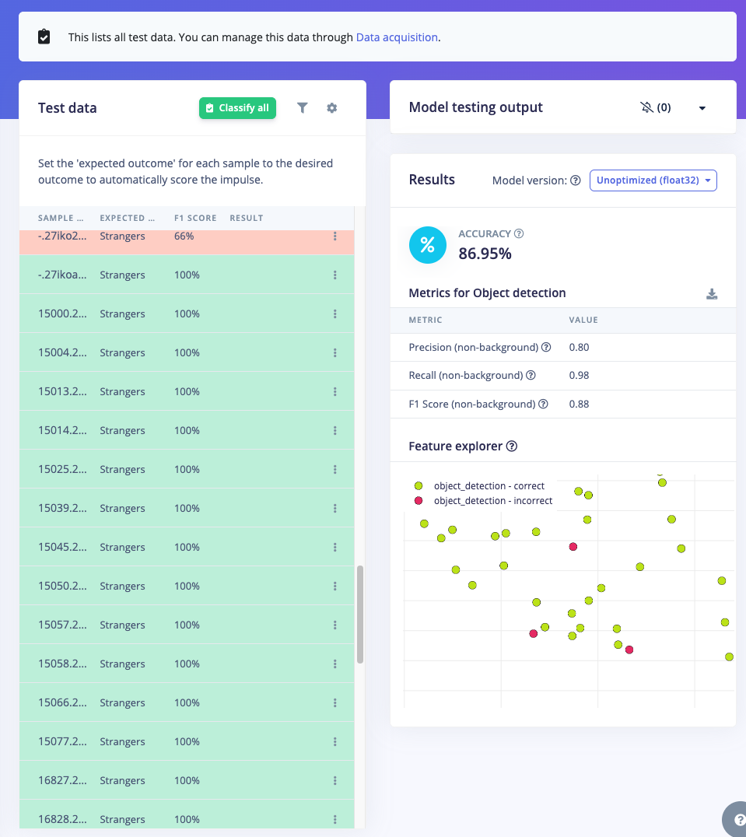
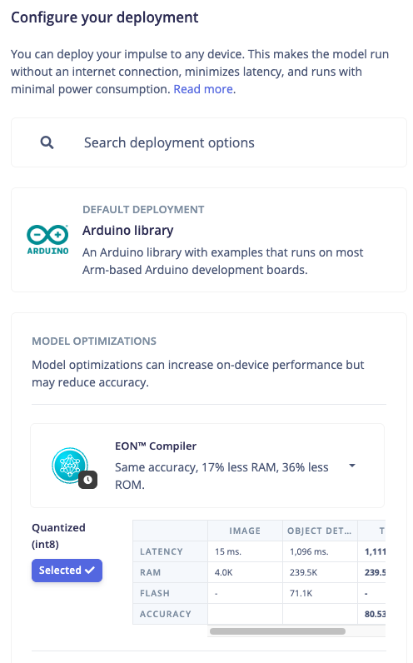



Edge Impulse Pipeline
Training
Validation
Deployment
Transfer learning (MobileNetV2).
Testing model accuracy vs F1 score.
Export as Arduino/C++ library.

Slide 8
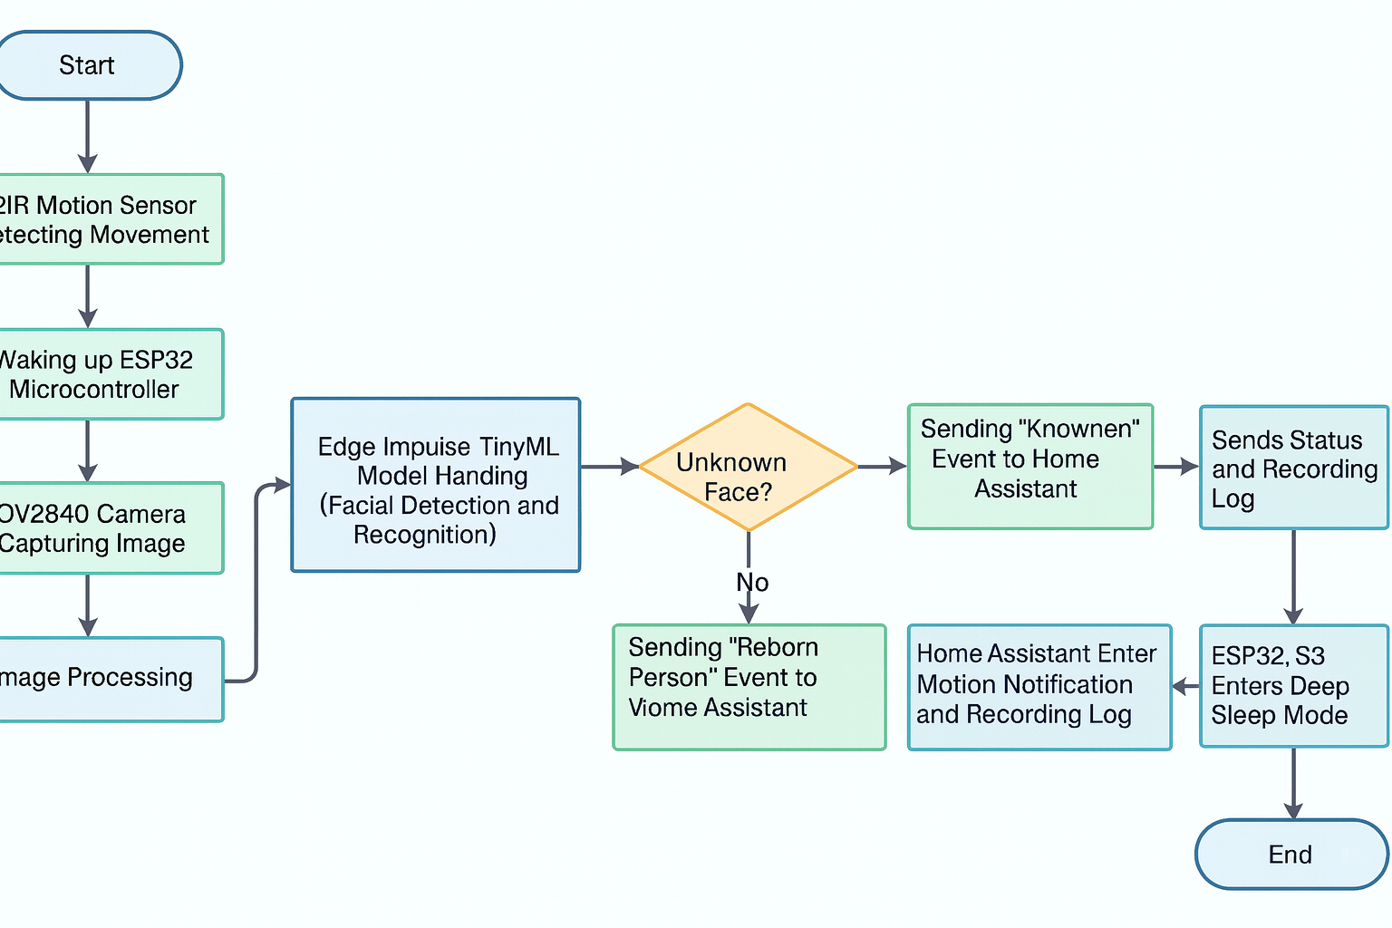
System Schematic
When the PIR sensor detects movement, it wakes up the ESP32-S3. The camera captures an image and processes it, then a TinyML model performs face detection and recognition. The system decides whether the face is known and sends the appropriate event to Home Assistant via MQTT. After logging and notifications, the ESP32-S3 enters deep-sleep mode to save power.

Slide 9
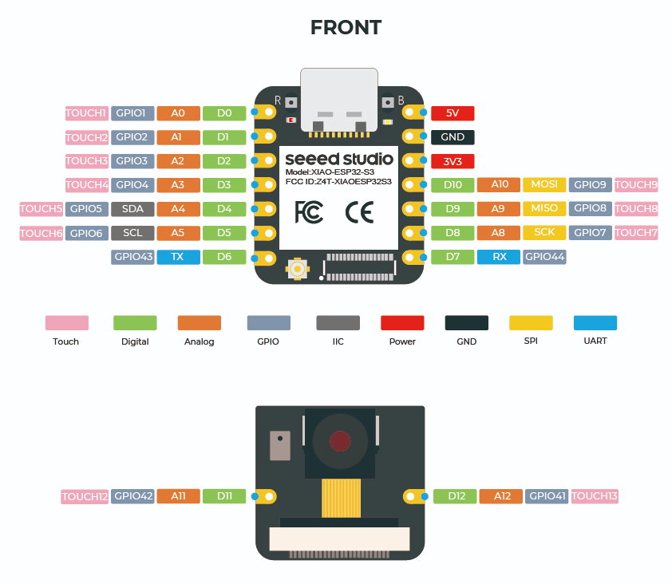
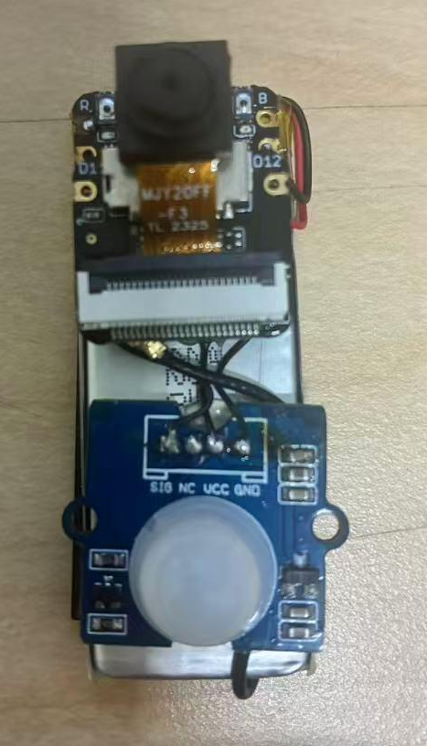
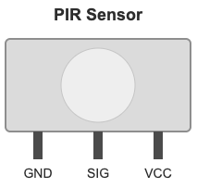
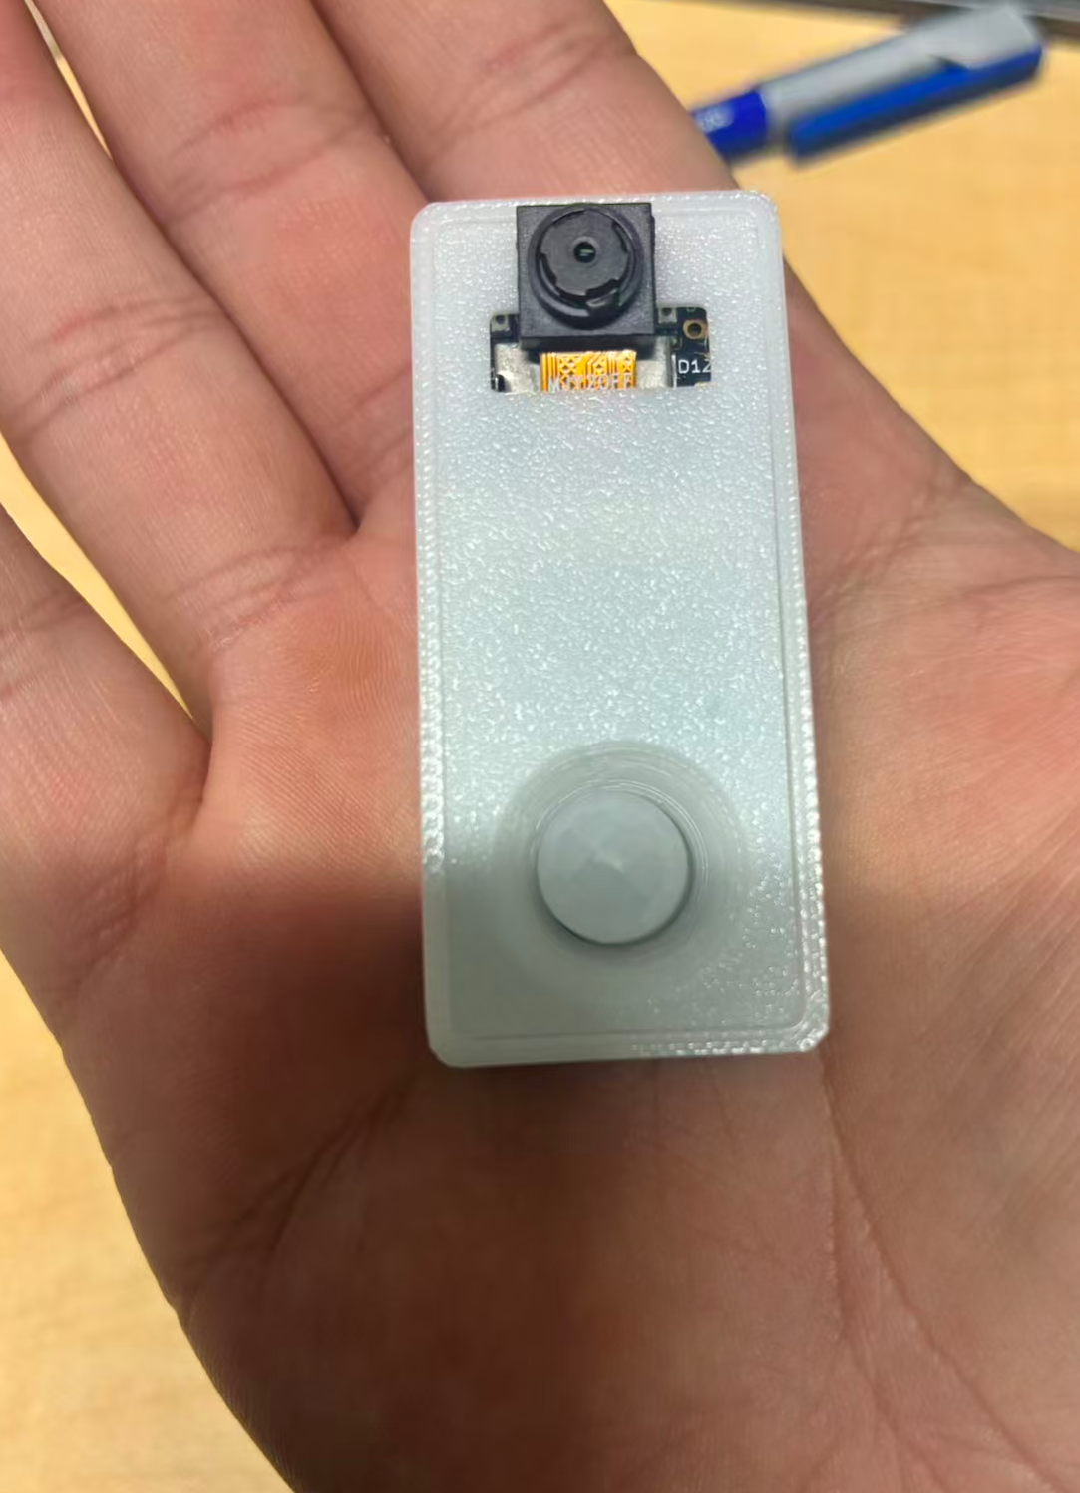
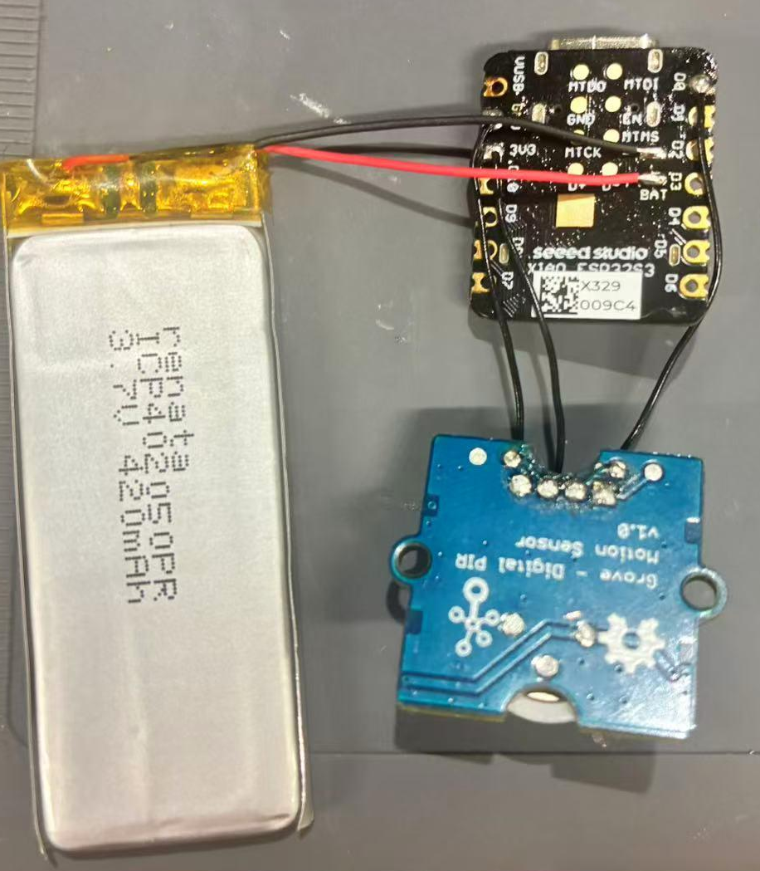
Hardware Stack
Core Components
MCU: Seeed Xiao ESP32-S3 Sense
Camera: OV2640 2MP Camera Module.
Sensor: Seeed Grove - Digital PIR Sensor
Power: 400mAh 3.7V Li-Po Battery
Housing: Custom 3D Printed PLA Enclosure.
Dimensions: 24x55x17 mm
Cost: 13+4+2+1 = 20 USD

Slide 10
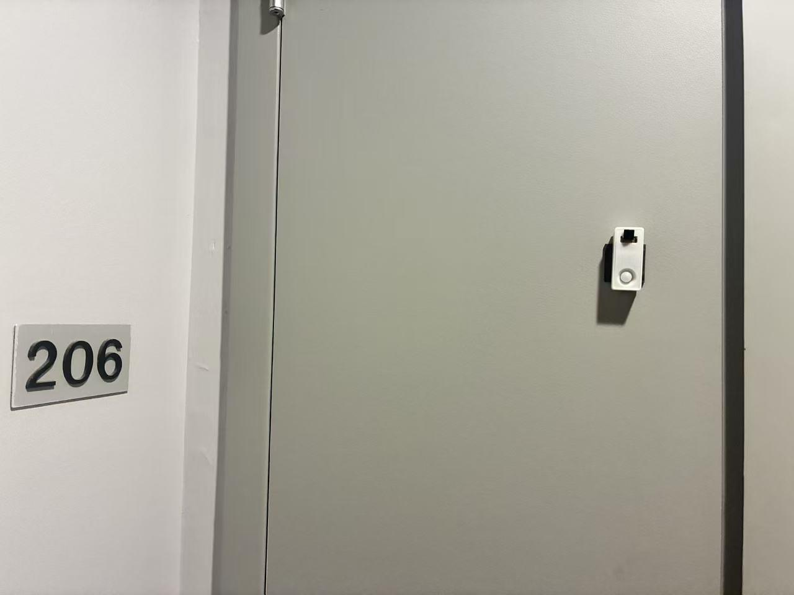
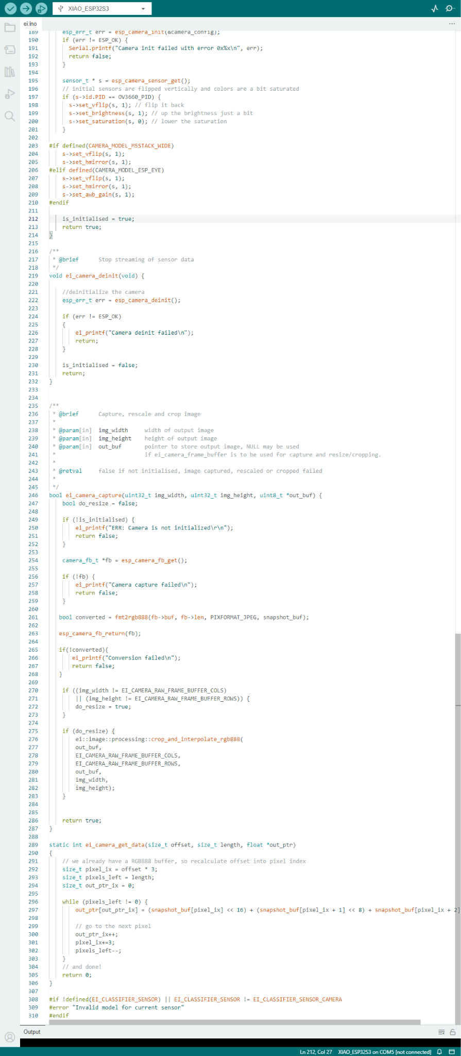
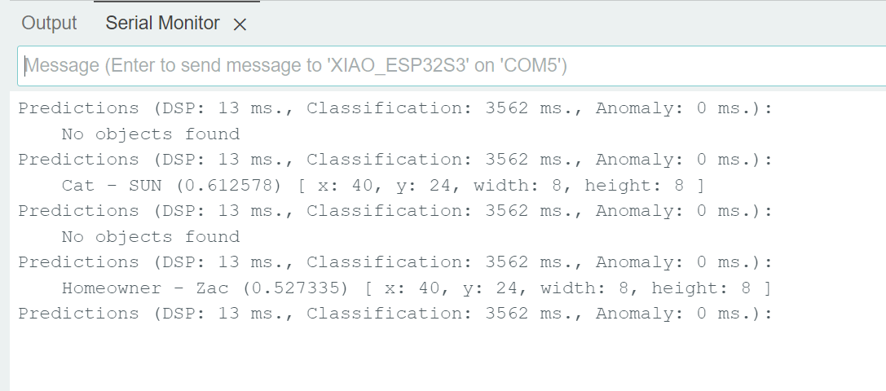
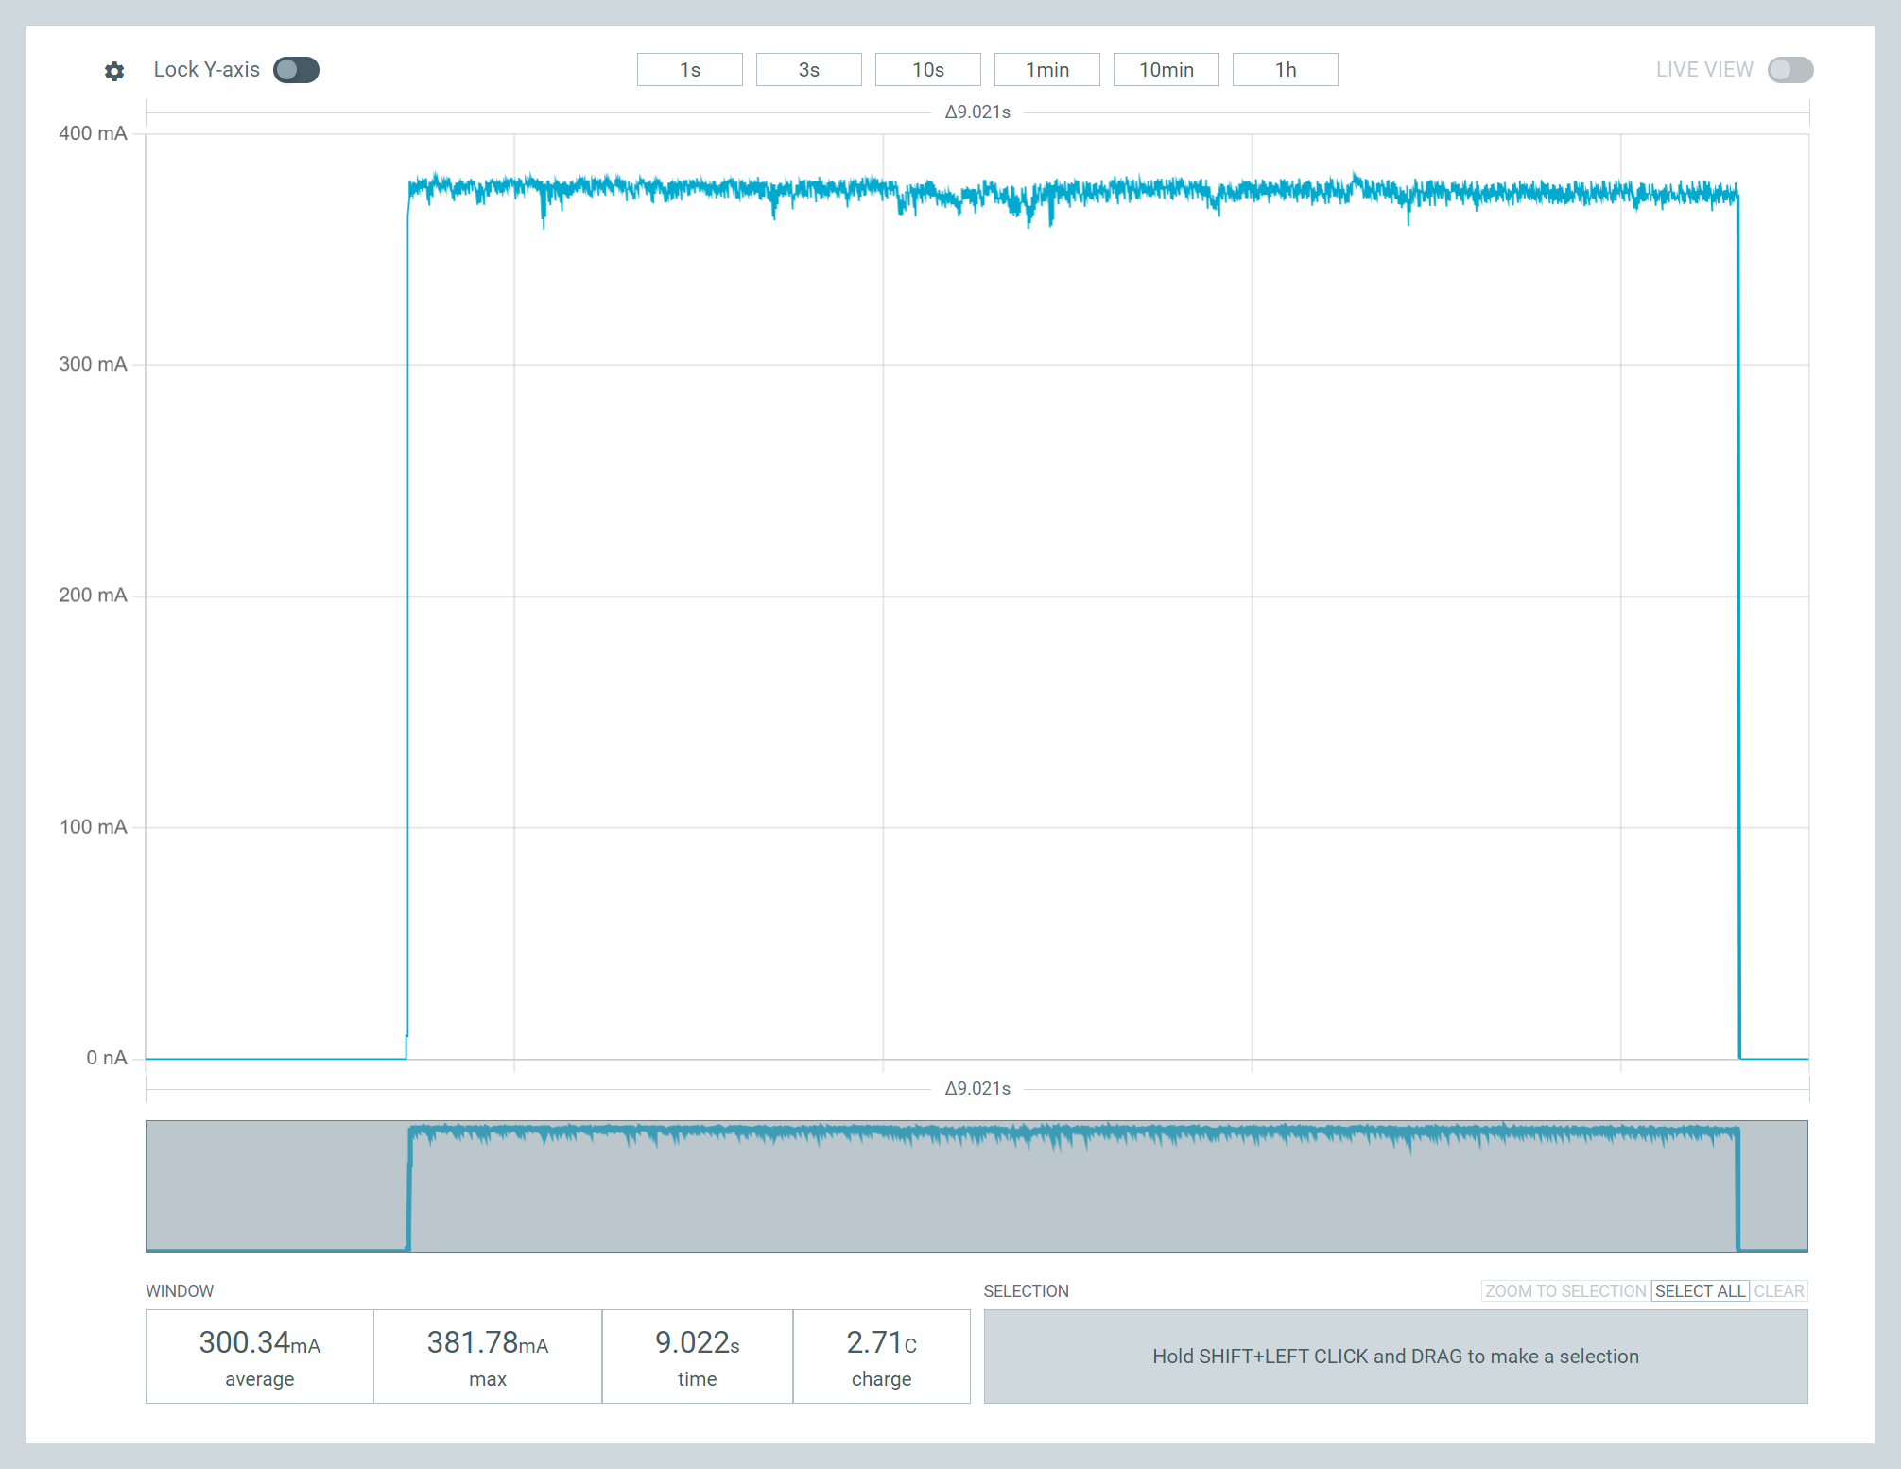
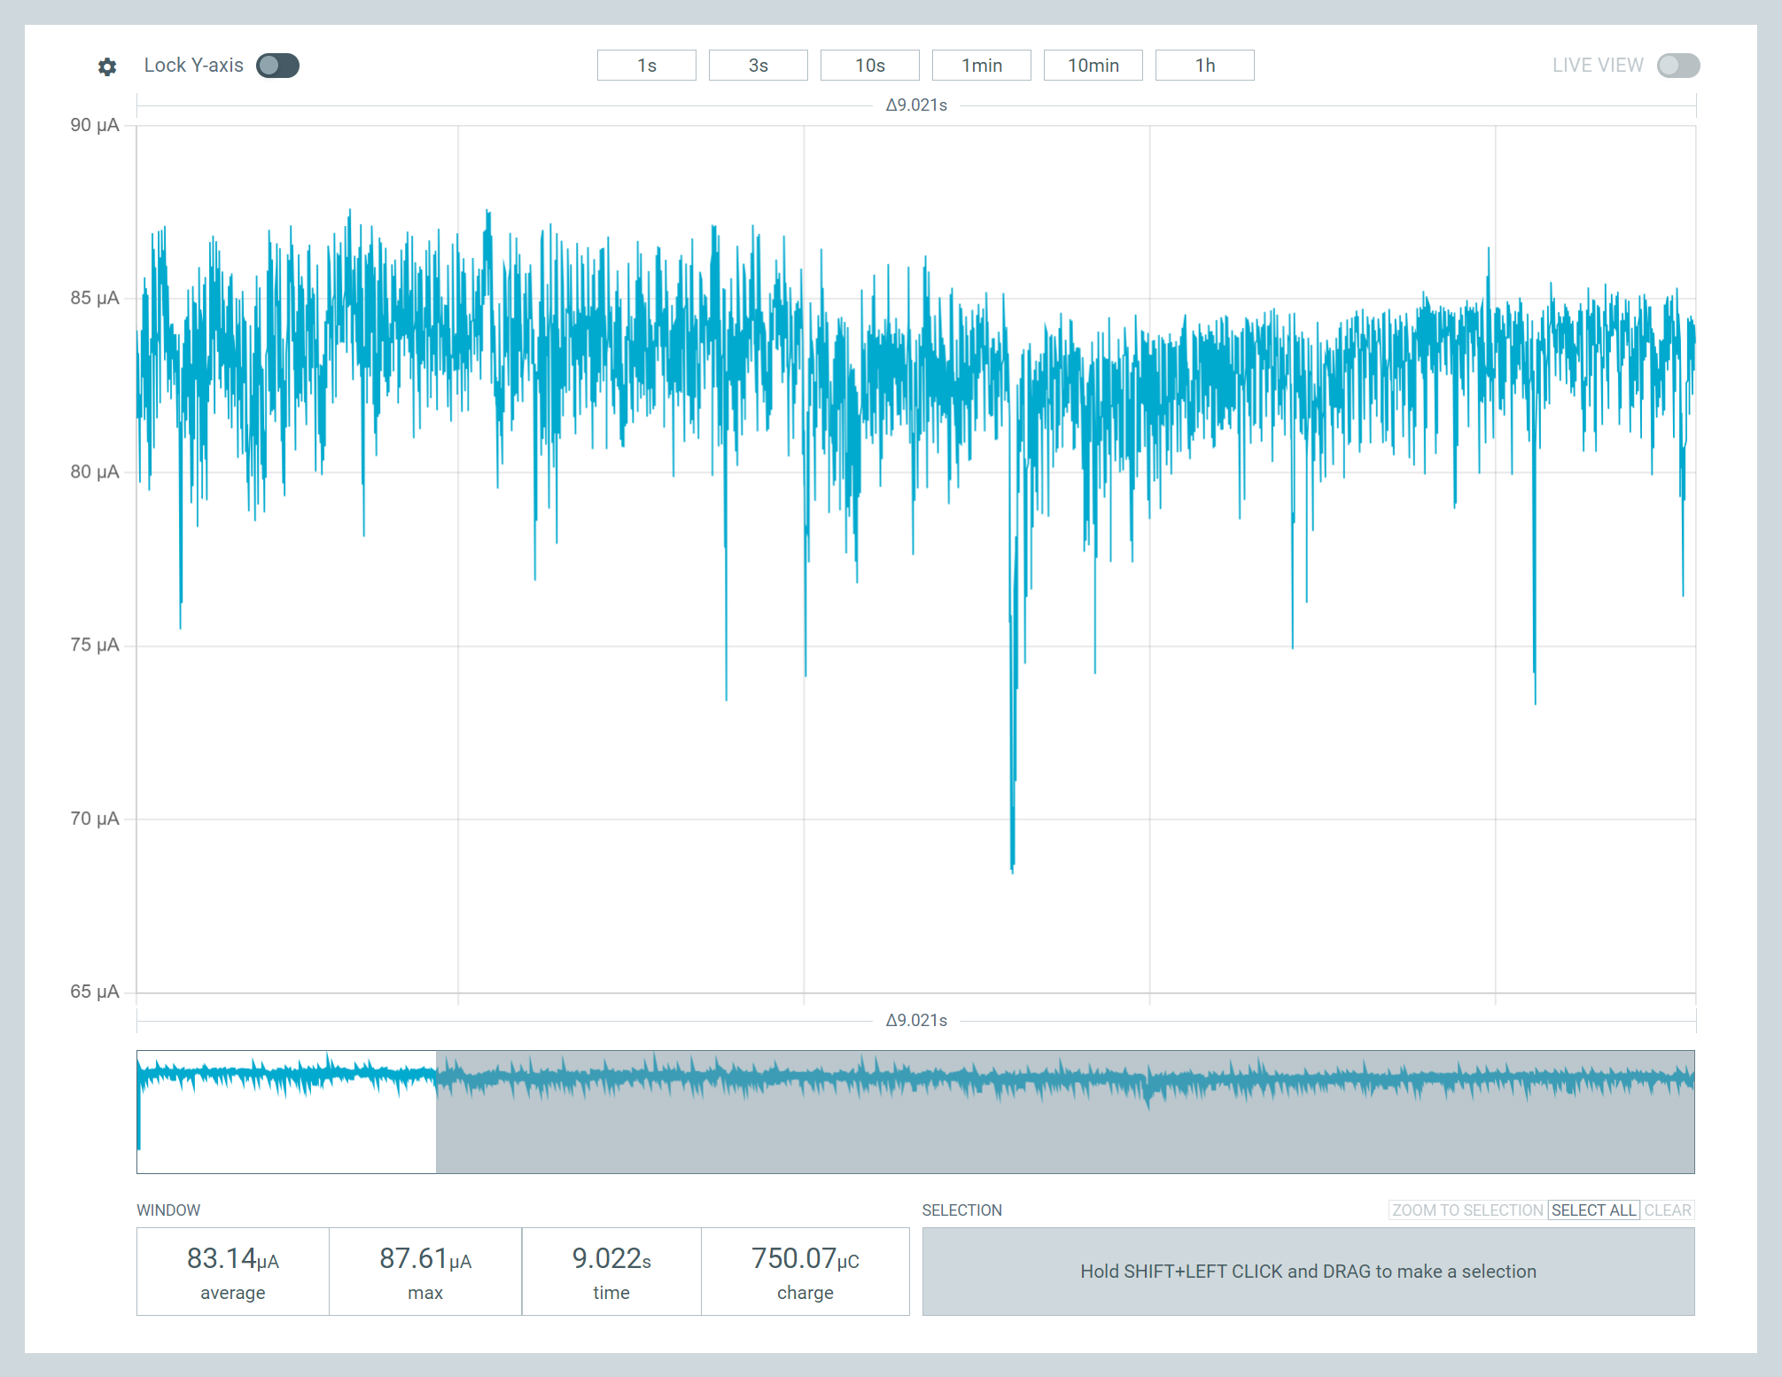
Real Environment Testing
380mA Work Mode
83uA Sleep Mode
The system was deployed in a real-world scenario to validate reliability.
Conditions: Tested in varying lighting conditions (direct sunlight vs porch shade). The model successfully identified residents while ignoring non-human motion triggers.
400mAh battery can work for 32 days, based on the assumption of 10 sec per detection, 10 times detection a day

Slide 11
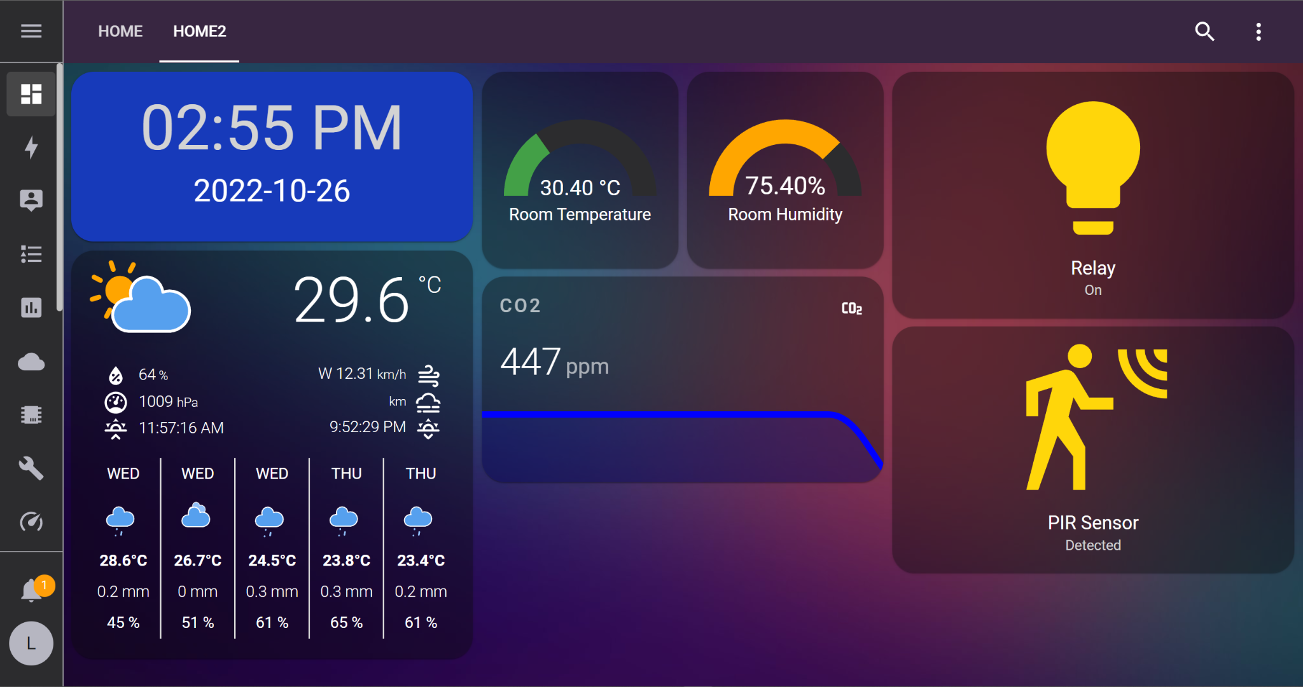
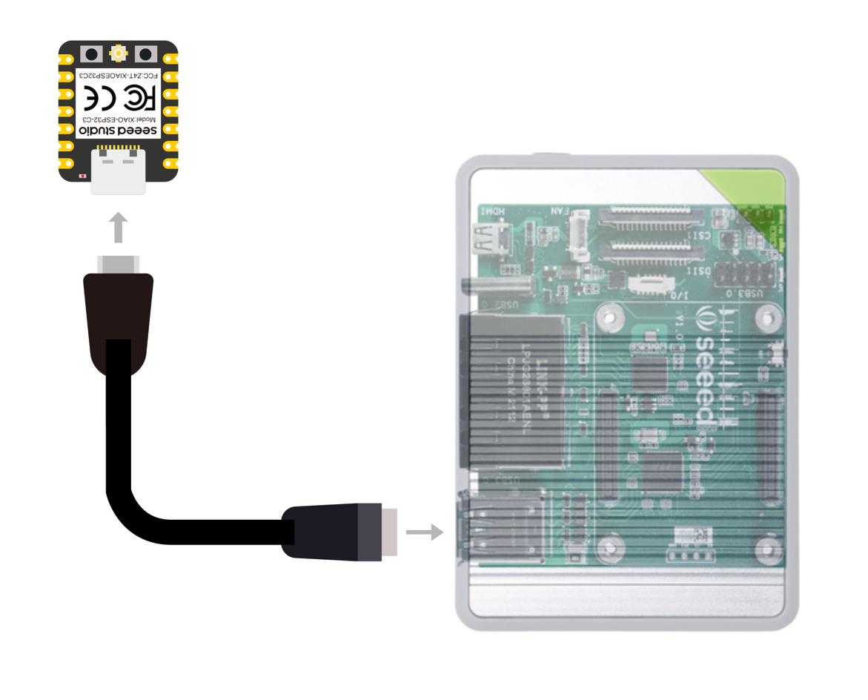
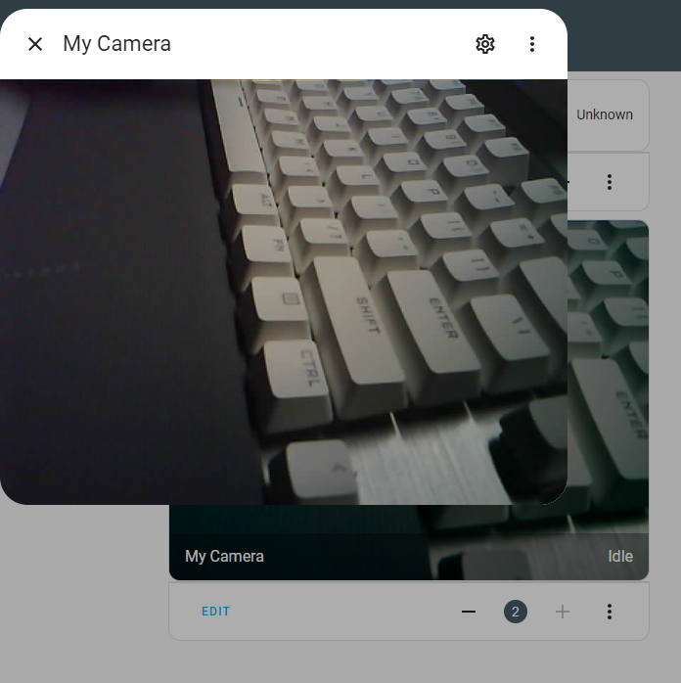
See my another github: https://github.com/Zachay-NAU/ESPHome-Support-on-Seeed-Studio-XIAO-ESP32S3
Home Assistant Insertion
The doorbell communicates with Home Assistant via the MQTT protocol over Wi-Fi.
Triggers: Doorbell camera sends an instant notification to mobile devices.
Automation: "Person Detected" event triggers porch lights to turn on automatically.
Dashboard: Displays last captured image and battery status.

